Slide 1
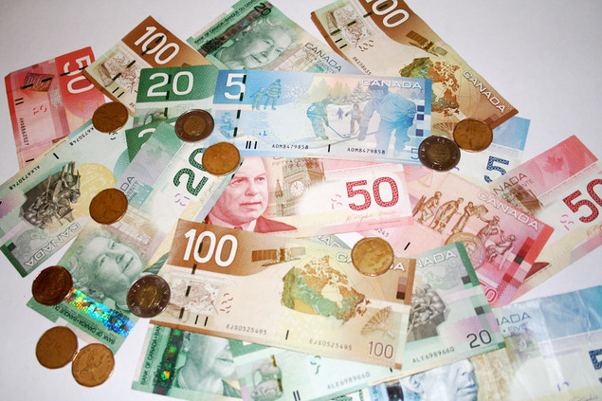
Money

Slide 2
How do you use Money?
Money is something you use to buy something
You can use money to buy goods and services
You will give over money in order to get a good
You will give over money in order to get a service

Slide 3
What is a ‘good’?
A good is a thing that you can buy
Here are some examples of ‘goods’:
Clothes (t-shirts, hats, jeans, hoodies, etc.)
Electronics (cell phones, laptop computers, televisions, game consoles, etc.)
Food and groceries (chips, milk, vegetables and fruit, meat, gum, etc.)
Sports equipment (soccer cleats, basketballs, hockey sticks
Can you give any other examples?

Slide 4
What is a ‘service’?
A service is someone or a company does something for you and you pay for it
Here are some examples of services:
House cleaning
Lawn cutting
Plumber coming to fix something
Taxi
Mechanic fixes a car
The electricity company gives your house electricity
Can you think of any other examples?

Slide 5
Good or Service?

Slide 6
Good or Service?

Slide 7
Good or Service?

Slide 8
Good or Service?

Slide 9
Good or Service?

Slide 10
Good or Service?

Slide 11
Good or Service?

Slide 12
Good or Service?

Slide 13
Good or Service?

Slide 14
Good or Service?

Slide 15
Where can I buy goods and service?
You can buy goods and services at:
Stores
Restaurants
On the internet
On the phone

Slide 16
What does ‘spending’ mean?
The word ‘spending’ means that you are giving money for a good or service
You spend money when you buy goods
You spend money when you buy services
Once you spend (give) the money on a good or service, that money does not belong to you
Who does the money belong to once you spend it?

Slide 17
Did I spend money?
I bought 2 hamburgers from Wendy’s.
I spent $150.00 on videogames.
I didn’t like any of the clothes I saw at Fairview, so I decided to wait until next week.
I paid that man to build those chairs.
I went to Walmart to buy pencils on sale for my students.
Those chips cost me two dollars a bag.
I decided to eat at home so I didn’t get a hotdog at La Belle Province.

Slide 18
Canadian Money/ Canadian Currency
In Canada, we use coins and bills as our currency.
Our currency is called dollars and cents.
Other countries can use other names for their currency.
Canadian currency looks different from the currency of other countries

Slide 19
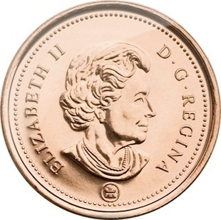
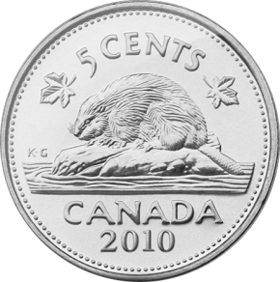
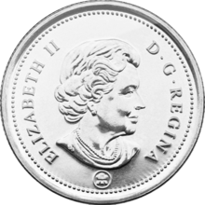
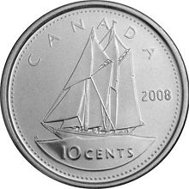
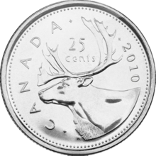
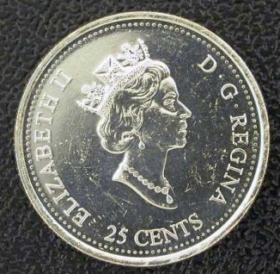
Canadian Coins
Penny = 1 cent
Nickel= 1 cent
dime = 1 cent
Quarter = 1 cent

Slide 20
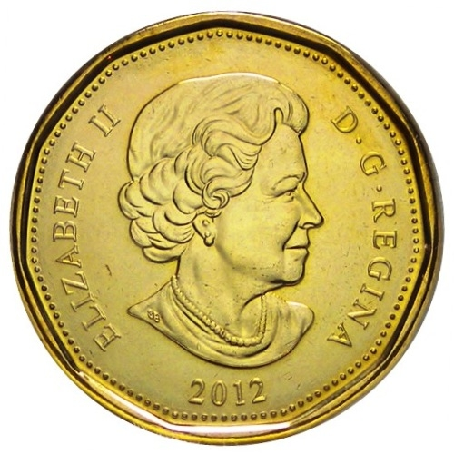
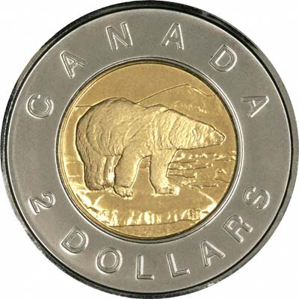
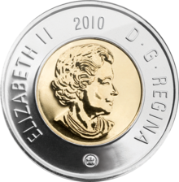
Canadian Coins
Loonie = 1 dollar
Toonie = 2 dollars

Slide 21
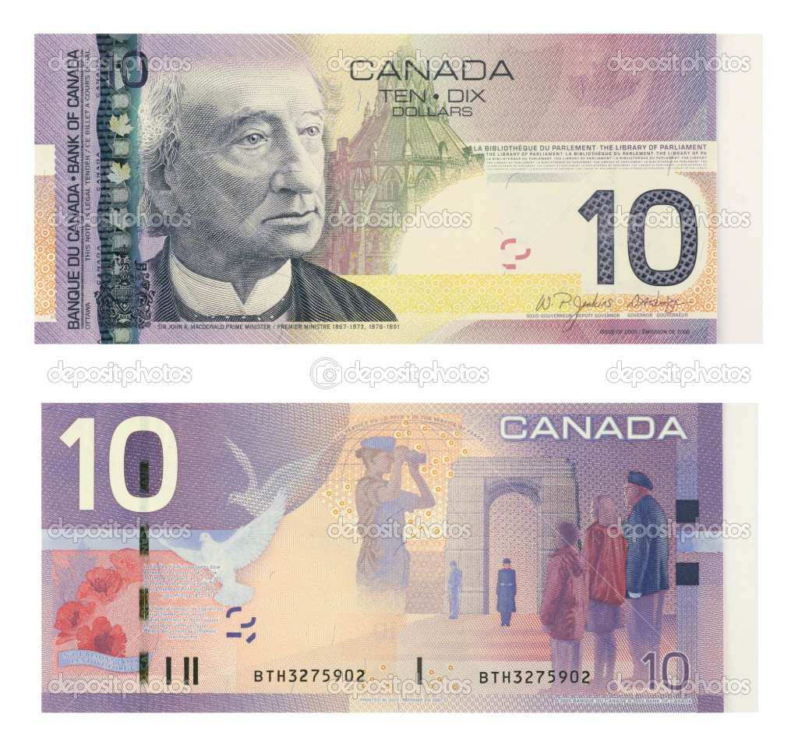
Canadian Bills
5 dollar bill
10 dollar bill

Slide 22
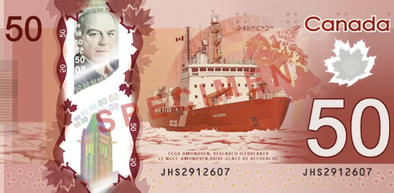
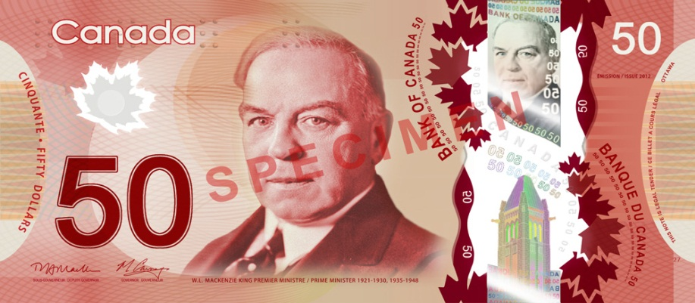
Canadian Bills
20 dollar bill
50 dollar bill

Slide 23
Canadian Bills
100 dollar bill

